Slide 1
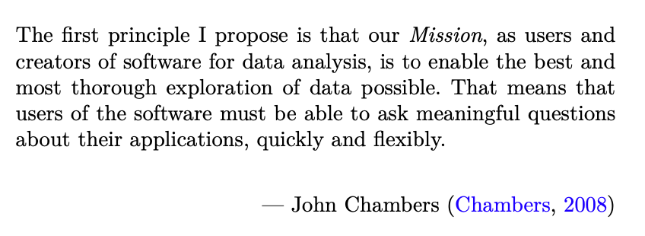

Exploring Operations Research with R: A Workshop
01 - Introduction
https://github.com/JimDuggan/Exploring-OR-with-R-Workshop

Slide 2

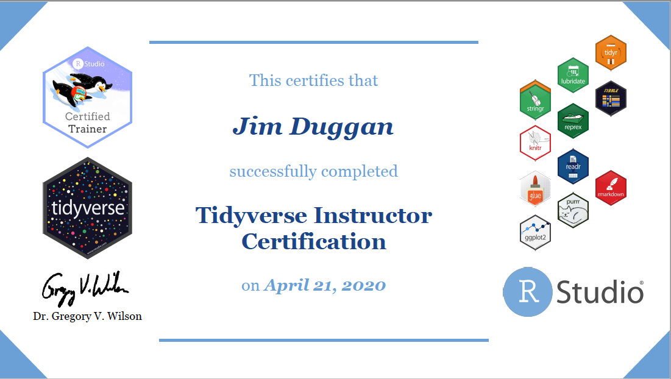
Instructor –Jim Duggan
Lectures in
Programming (R, MATLAB, Python),
Modelling & Simulation
Research interests:
System Dynamics
Public Health
Data Science
https://education.rstudio.com/trainers/people/duggan+jim/

Slide 3
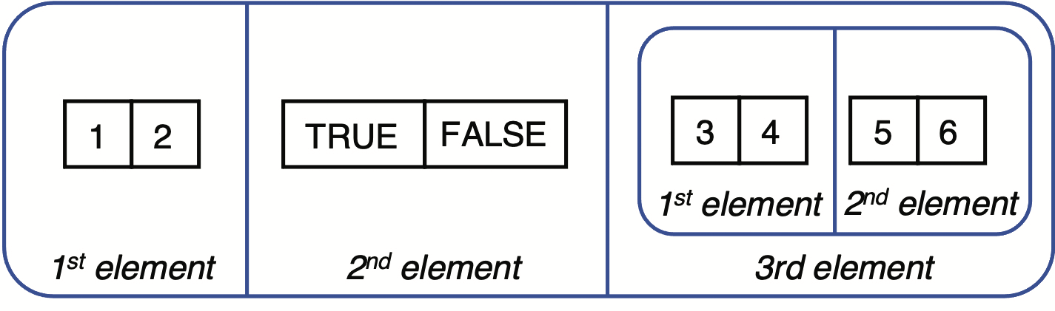
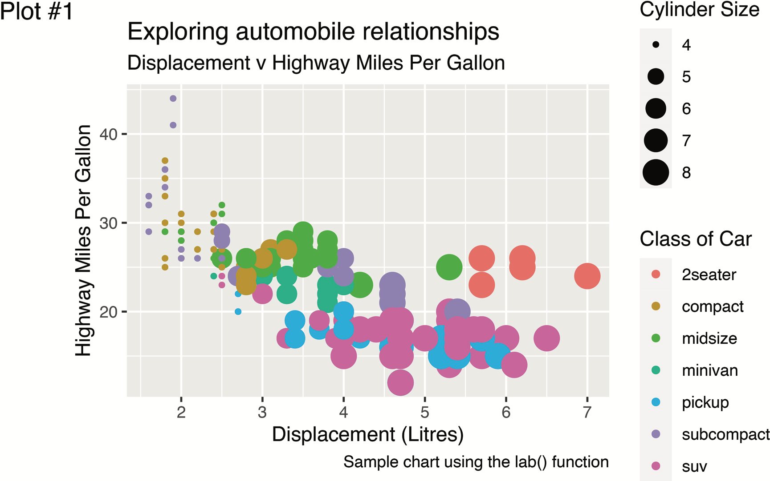
Goal
Show how the R programming language can be a valuable tool – and way of thinking – which can be successfully applied to the field of operations research (OR).
Core R tools (tidyverse)
Application areas to OR:
Exploratory Data Analysis
Linear Programming
Agent-Based Simulation
System Dynamics

Slide 4
Topics Overview
Topic | Description | ~Timing
1 | Introduction to R and Posit Cloud | 10 mins
2 | Storing data using data frames / tibbles | 10 mins
3 | Visualisation with ggplot2 | 20 mins
4 | Data transformation with dplyr | 20 mins
5 | Using R with OR – Four Examples | 30 mins

Slide 5

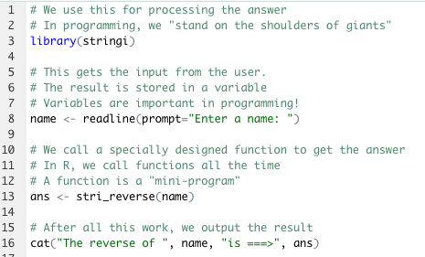
The R Project for Statistical Computing
R’s mission is to enable the best and most thorough exploration of data possible (Chambers 2008).
It is a dialect of the S language, developed at Bell Laboratories
ACM noted that S “will forever alter the way people analyze, visualize, and manipulate data”

Slide 6
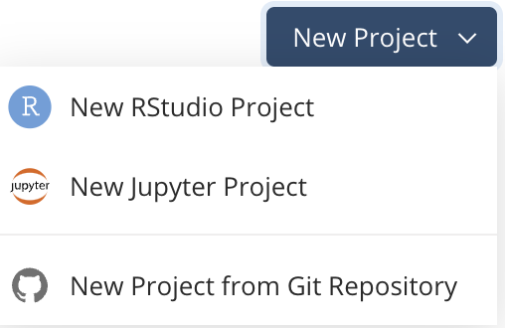
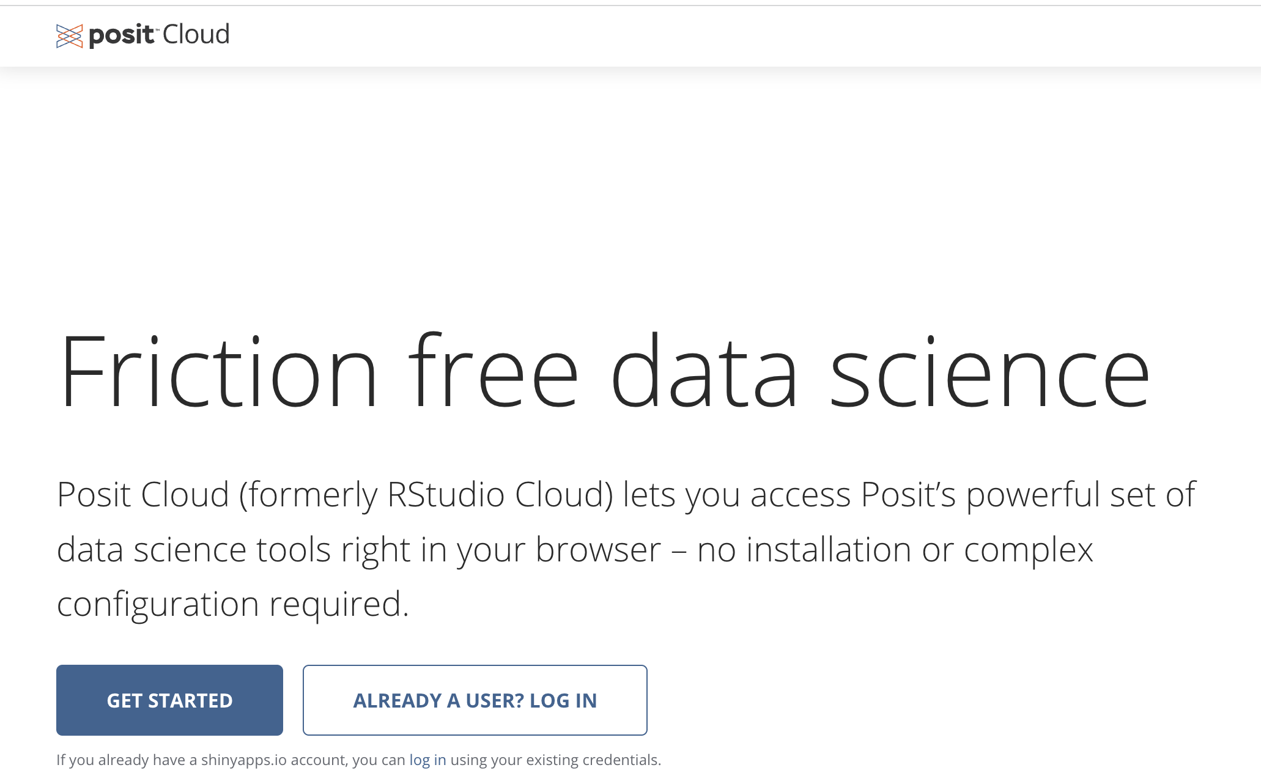
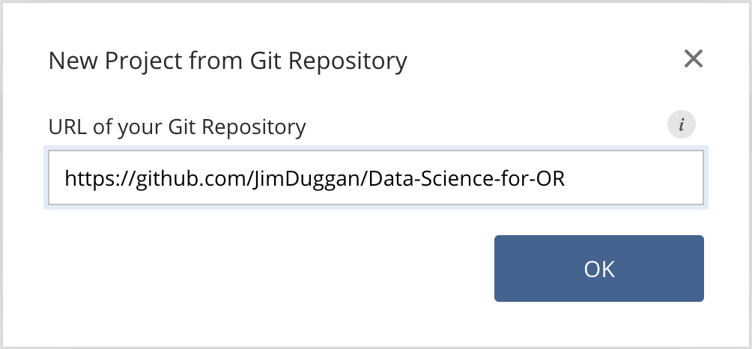
First Steps: Posit Cloud – Create Your Account

Slide 7
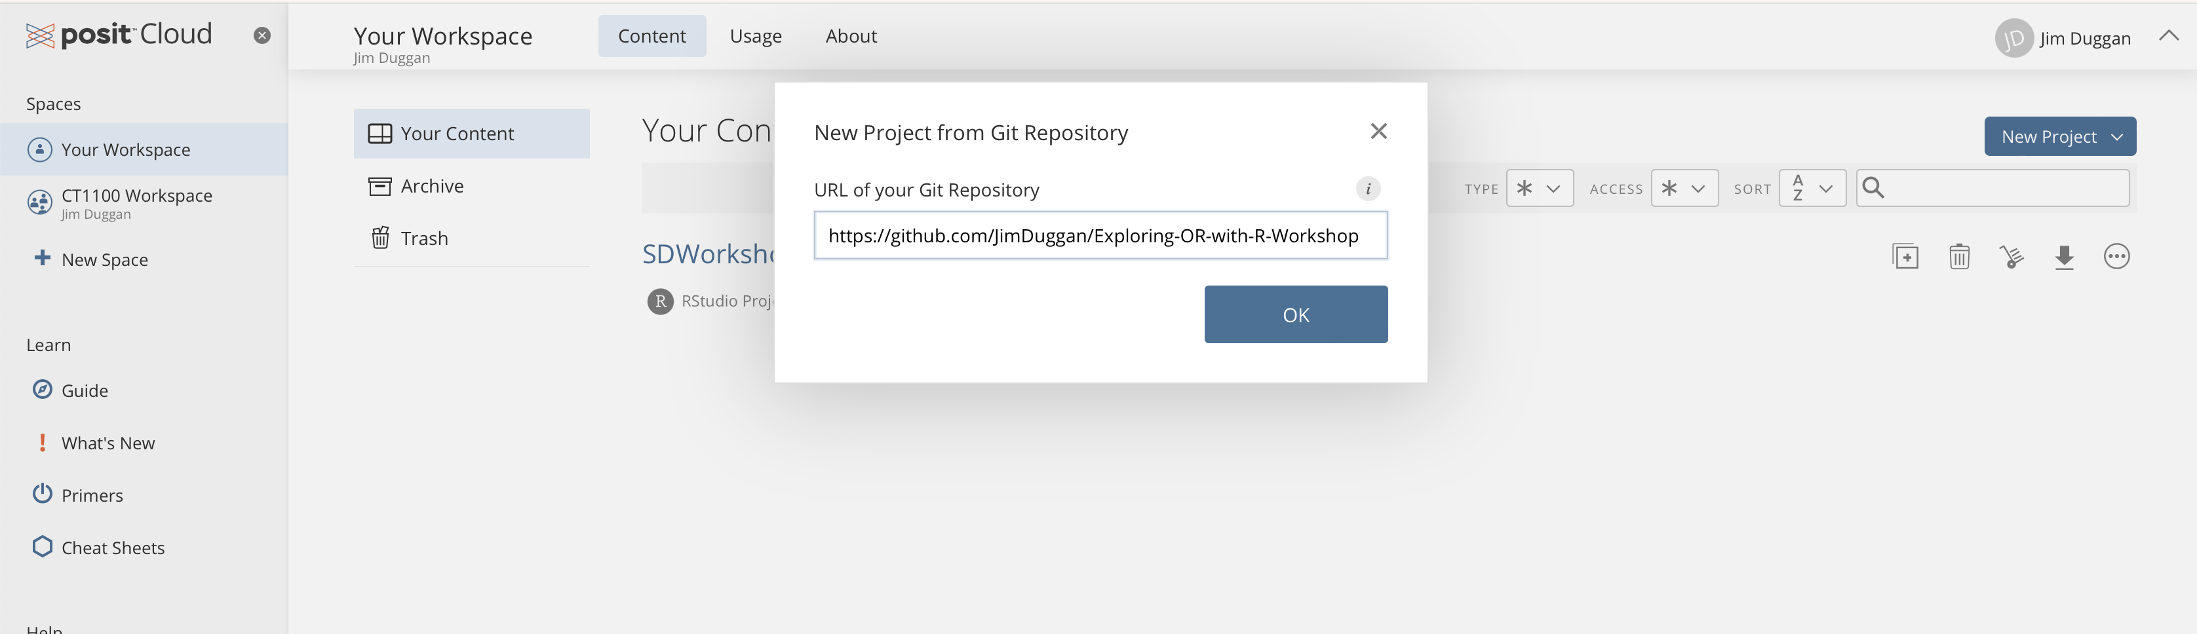
Install the codebase from github…

Slide 8
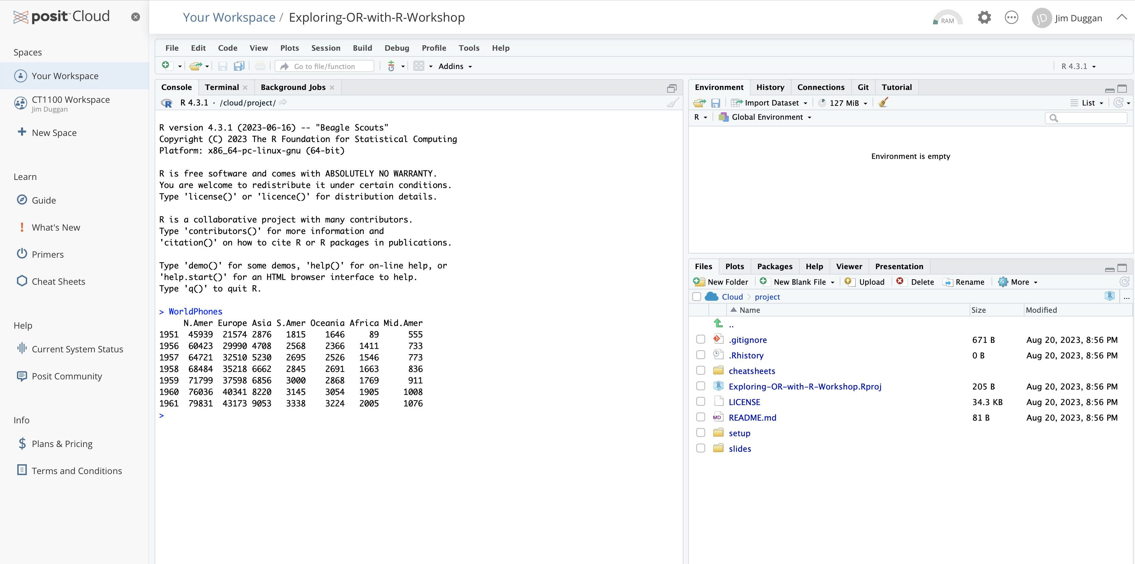
IDE Available for running scripts

Slide 9
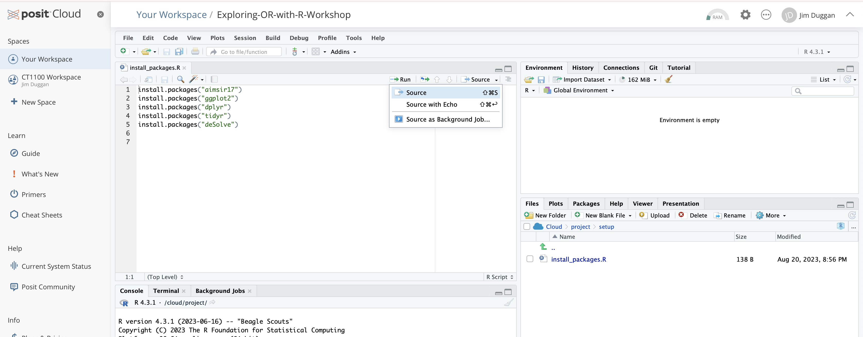
Run setup file…

Slide 10
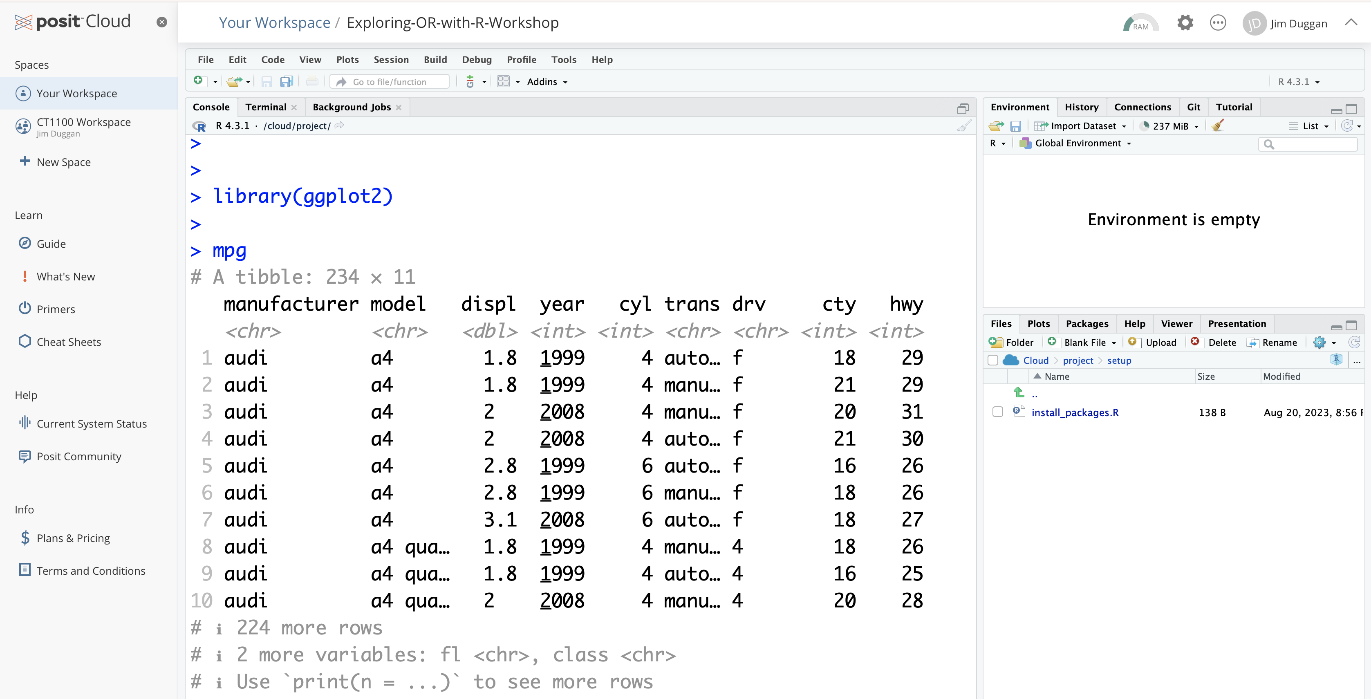
A quick check… the ggplot2 mpg dataset

Slide 11
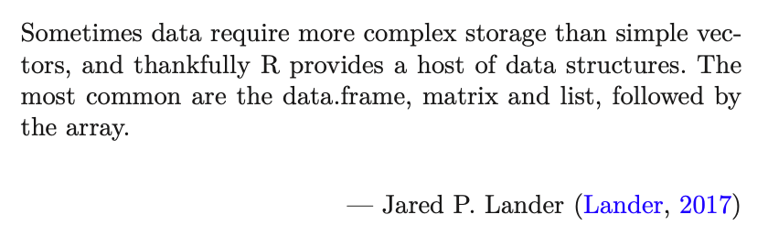
Exploring Operations Research with R: A Workshop
02 - Tibbles
https://github.com/JimDuggan/Exploring-OR-with-R-Workshop

Slide 12
Topics Overview
Topic | Description | ~Timing
1 | Introduction to R and Posit Cloud | 10 mins
2 | Storing data using data frames / tibbles | 10 mins
3 | Visualisation with ggplot2 | 20 mins
4 | Data transformation with dplyr | 20 mins
5 | Using R with OR – Four Examples | 30 mins

Slide 13
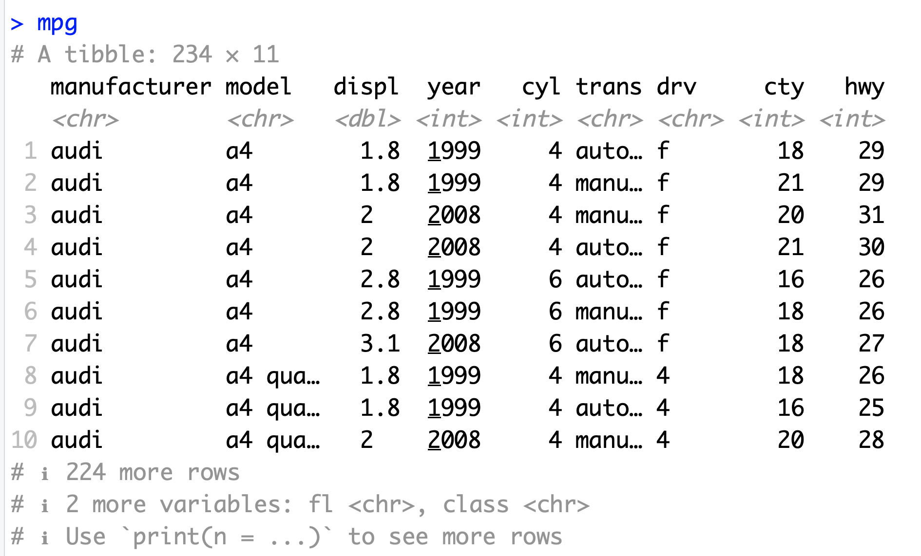
Data Frames/Tibbles
The most common way of storing data in R
A two-dimensional structure, with rows (observations) and columns (variables)

Slide 14
tibble abbreviations (variable types)
Abbreviation | Data Type
int | integers
dbl | doubles (real numbers)
chr | character vectors (strings
dttm | date-times
lgl | logical
fctr | factor (categorical variables with fixed possible values)
date | dates

Slide 15
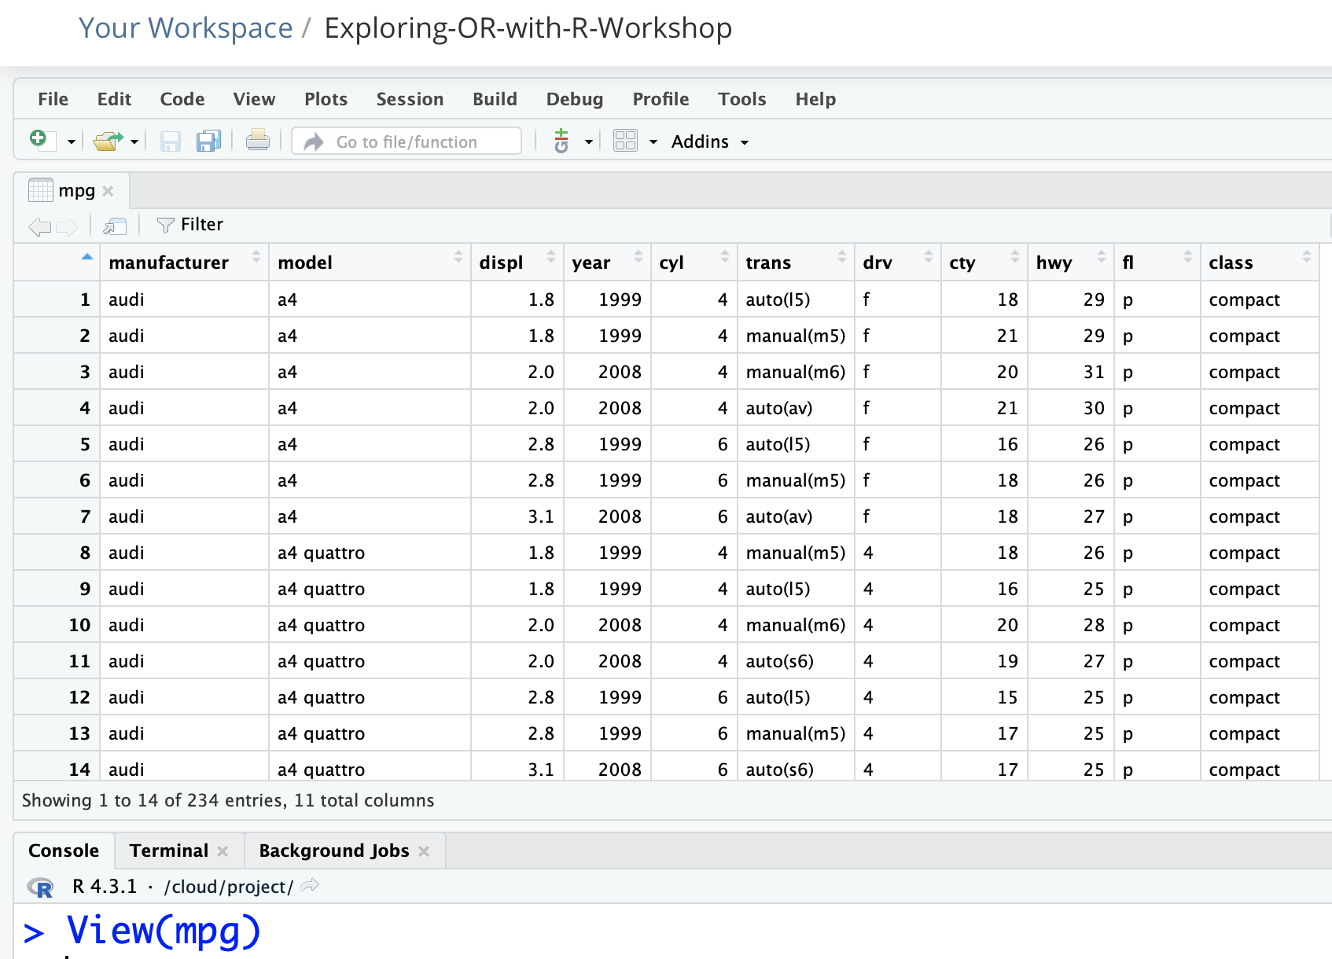
In the computer’s memory, just like a spreadsheet

Slide 16
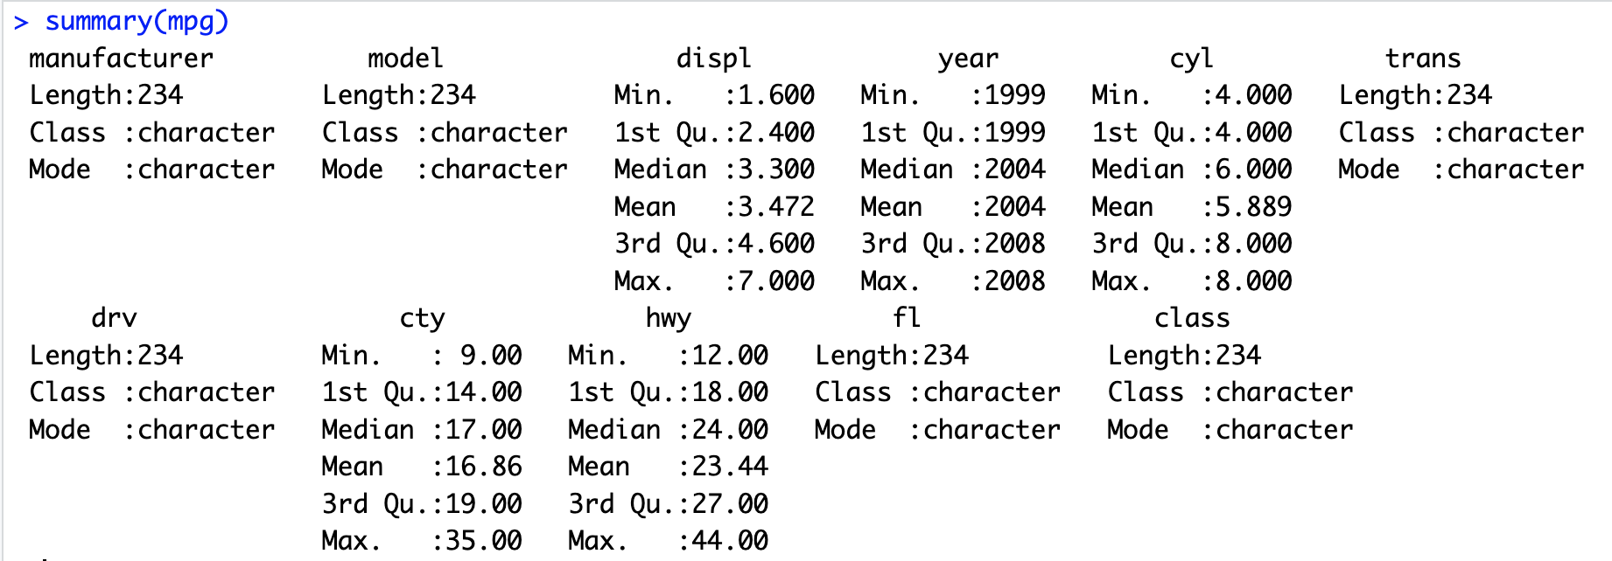
The summary() function

Slide 17
Challenge 2.1
Explore some of the following tibbles in R
mpg (ggplot2)
diamonds (ggplot2)
observations (aimsir17)
eirgrid17 (aimsir17)
stations (aimsir17)

Slide 18
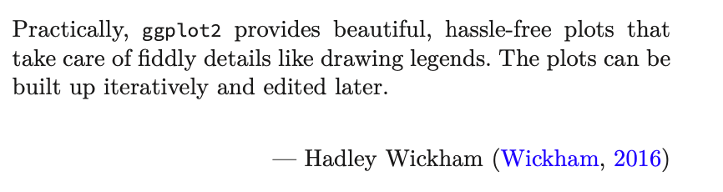
Exploring Operations Research with R: A Workshop
03 – ggplot2
https://github.com/JimDuggan/Exploring-OR-with-R-Workshop

Slide 19
Topics Overview
Topic | Description | ~Timing
1 | Introduction to R and Posit Cloud | 10 mins
2 | Storing data using data frames / tibbles | 10 mins
3 | Visualisation with ggplot2 | 20 mins
4 | Data transformation with dplyr | 20 mins
5 | Using R with OR – Four Examples | 30 mins

Slide 20
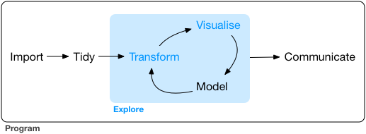
Data Exploration
“Data exploration is the art of looking at your data, rapidly generating hypotheses, quickly testing them, then repeating again and again and again.” (Wickham and Grolemund 2017).

Slide 21
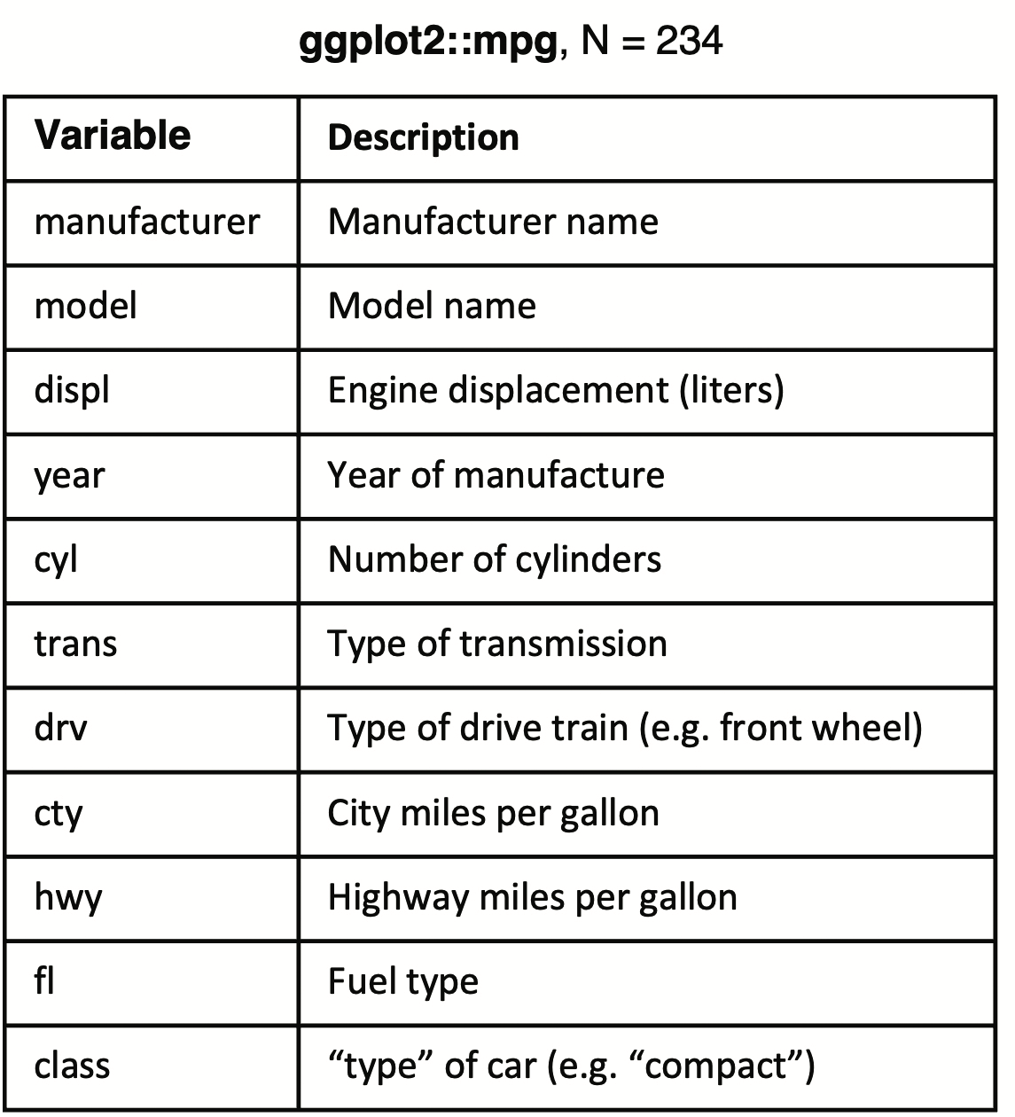
ggplot2
Layered grammar of graphics, enables us to concisely describe the components of a graphic.
Benefits:
plots can be designed in a layered manner (+ operator)
a wide range of plots can be generated to support decision analysis, including scatterplots, histograms and time series charts
charts can be developed rapidly, and this support an iterative process of decision support

Slide 22
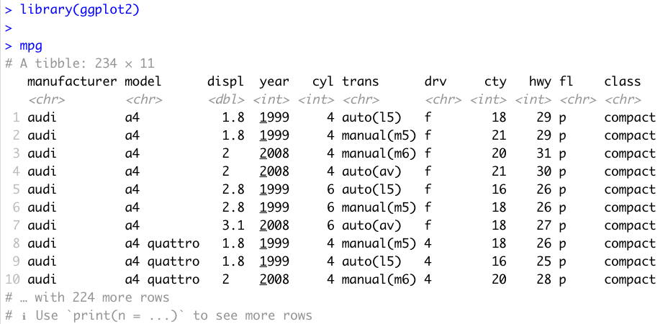
Data Visualisation with ggplot2
“The simple graph has brought more information to the data analyst’s mind that any other device.” – John Tukey

Slide 23
First Steps
Generate a first graph to help answer the following question:
Do cars with big engines use more fuel than cars with small engines
What might the relationship between engine size and fuel efficiency look like?
Need to draw a scatter plot

Slide 24
Selecting data (from columns)
Among the variables are:
displ, a car’s engine size in litres
hwy, a car’s fuel efficiency on the highway in miles per gallon

Slide 25
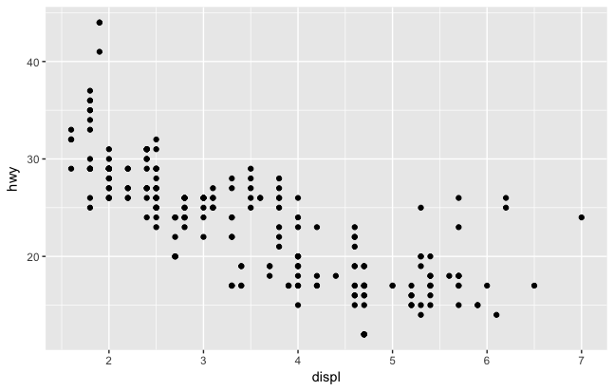
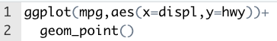
Creating a ggplot

Slide 26
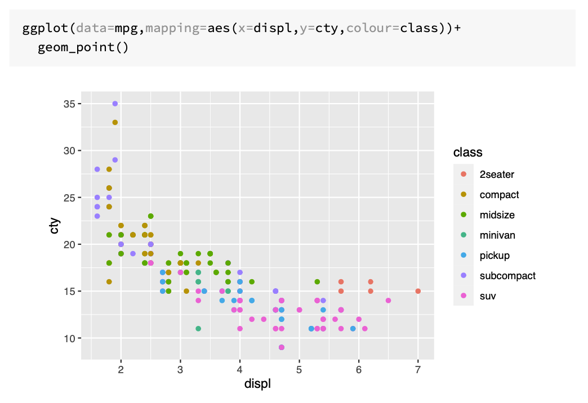

Slide 27
Customising Plot Appearance with lab()
Argument | Role
title | provides an overall title text for the plot
subtitle | adds a subtitle text
colour | allows you to specify the legend name for the colour attribute
caption | inserts text on the lower right hand side of your plot
size | allows you to name the size attribute
x | name the x-axis
y | name the y-axis
tag | text for tag label for top-left of plot

Slide 28
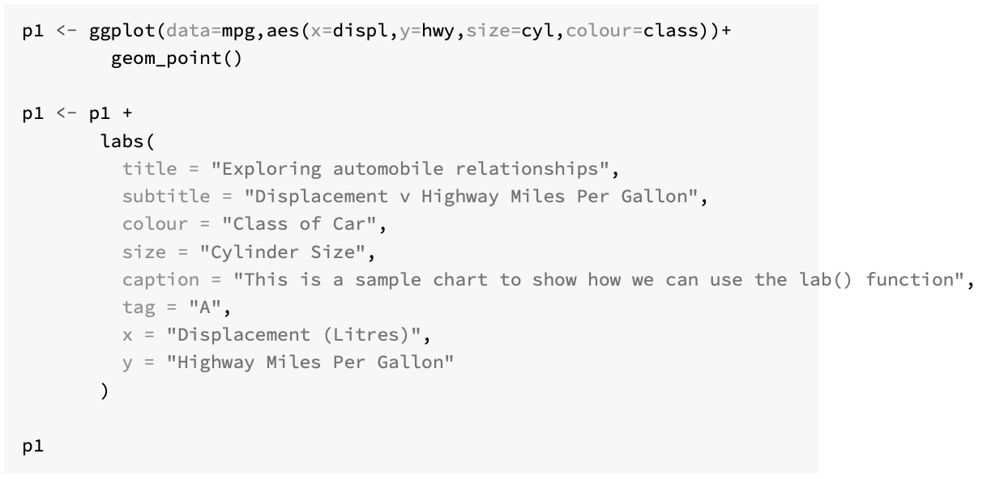

Slide 29
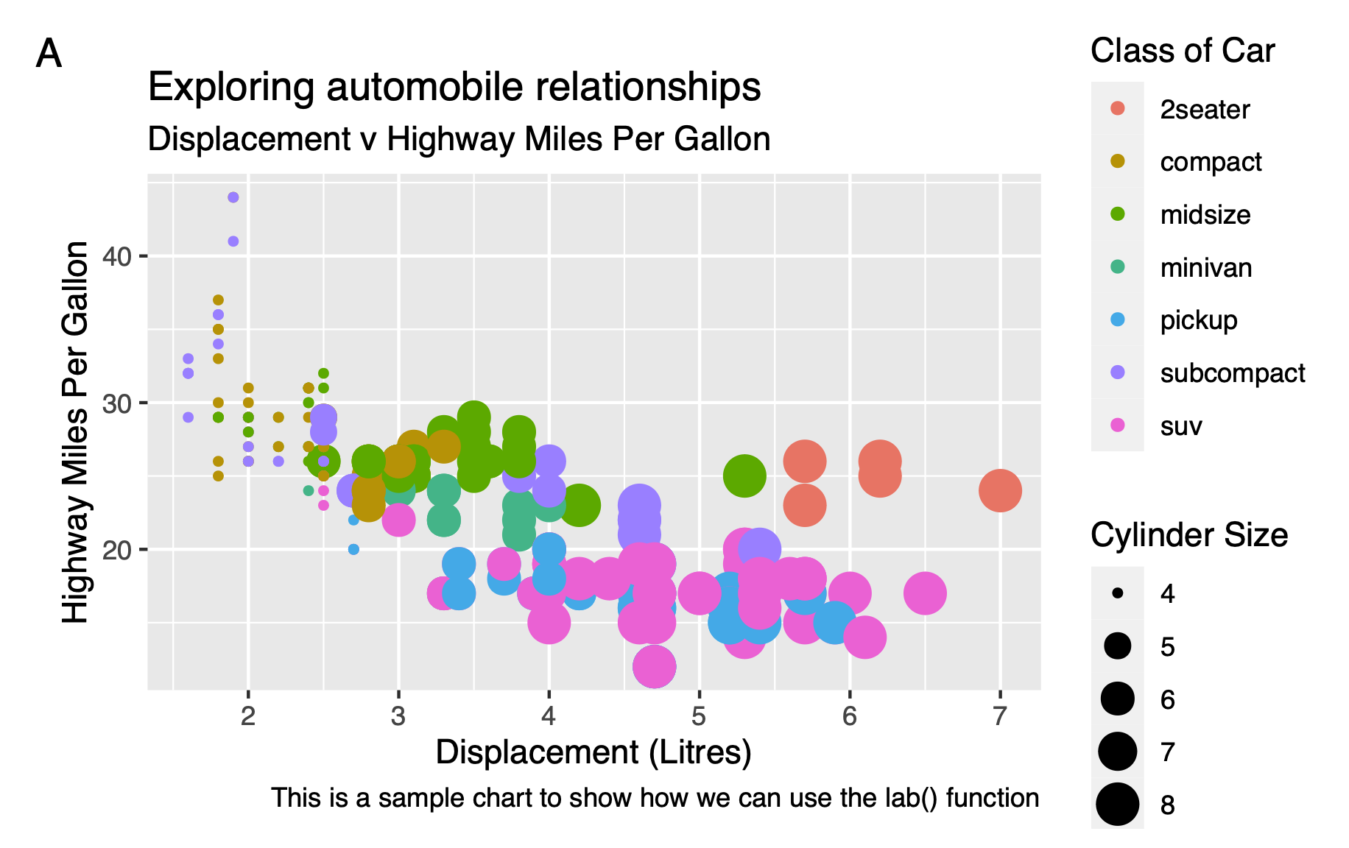

Slide 30
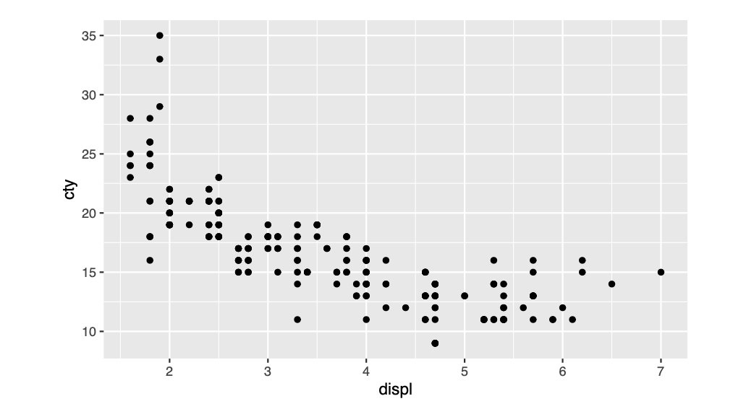
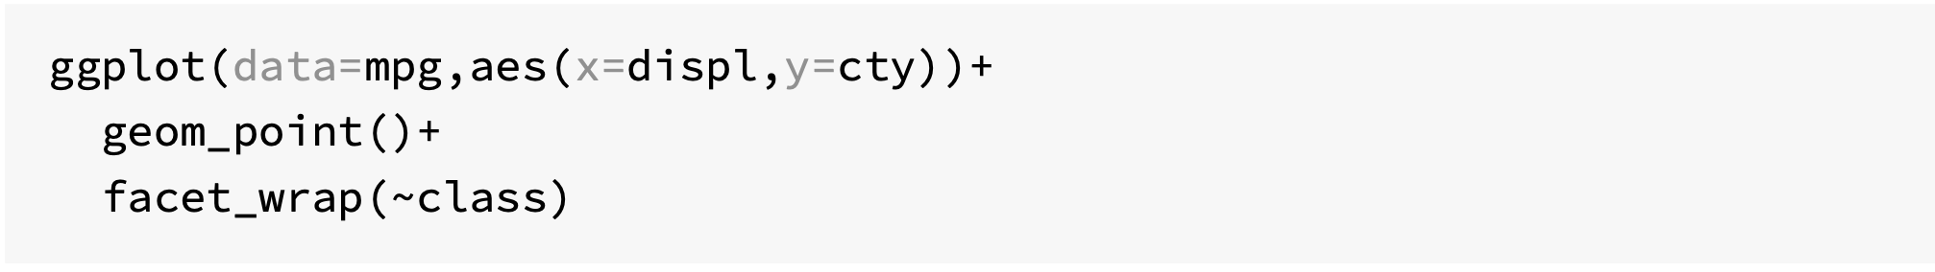
Subplots with Facets

Slide 31
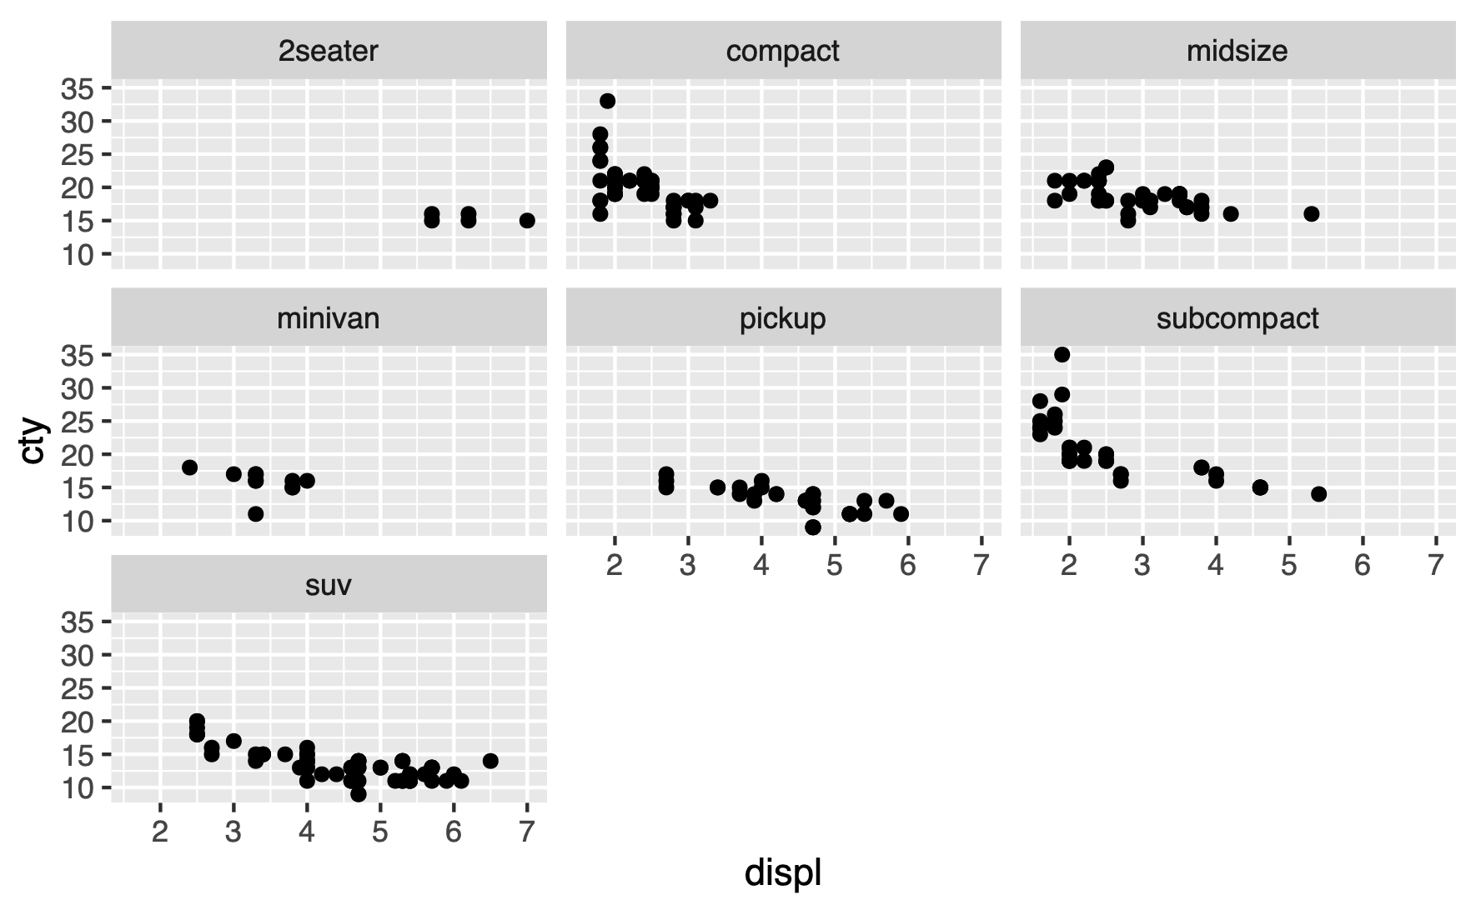

Slide 32
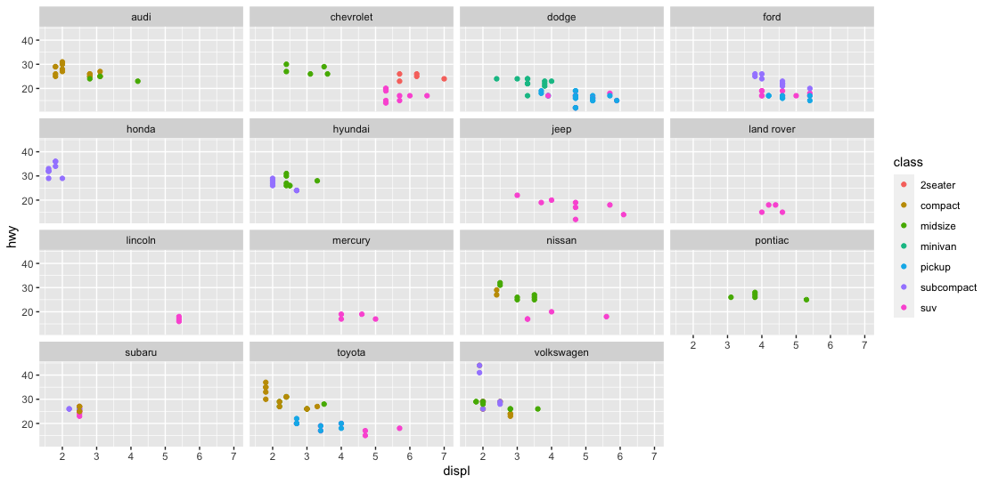
Challenge 3.1
Generate the following scatter plot (displ v hwy) from the tibble mpg (ggplot2 library)

Slide 33
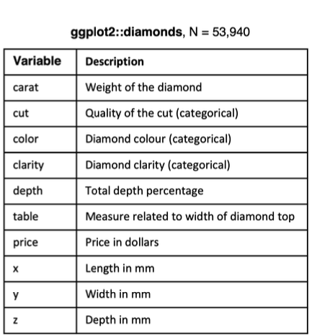
Statistical Transformations
Many graphs, like scatterplots, plot the raw values of the dataset
However, other graphs (e.g. bar charts) calculate new values to plot
Bar charts, histograms and frequency polygons bin your data and plot bin counts, the number of points that fall in each bin
Smoothers fit a model to your data and the plot predictions from the model
Boxplots compute a robust summary of the distribution and display a specially formatted box

Slide 34
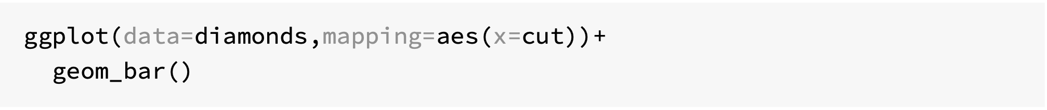
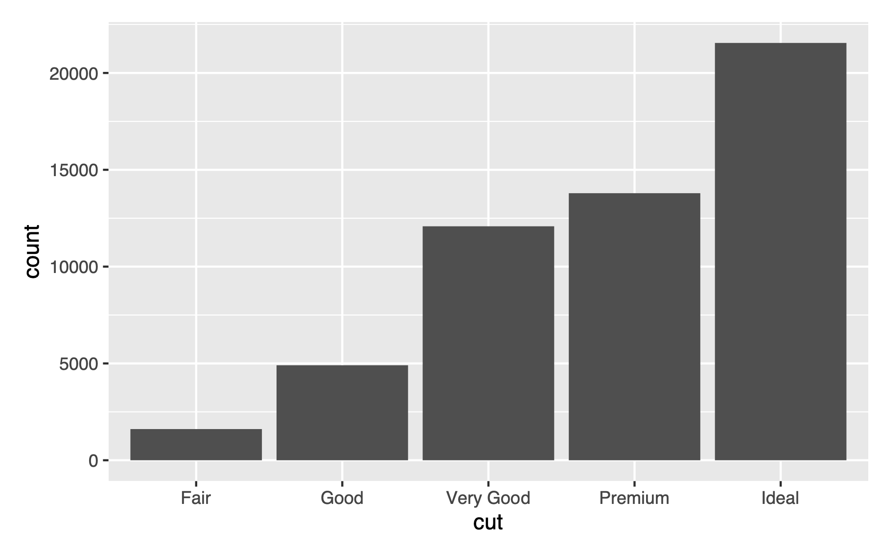

Slide 35
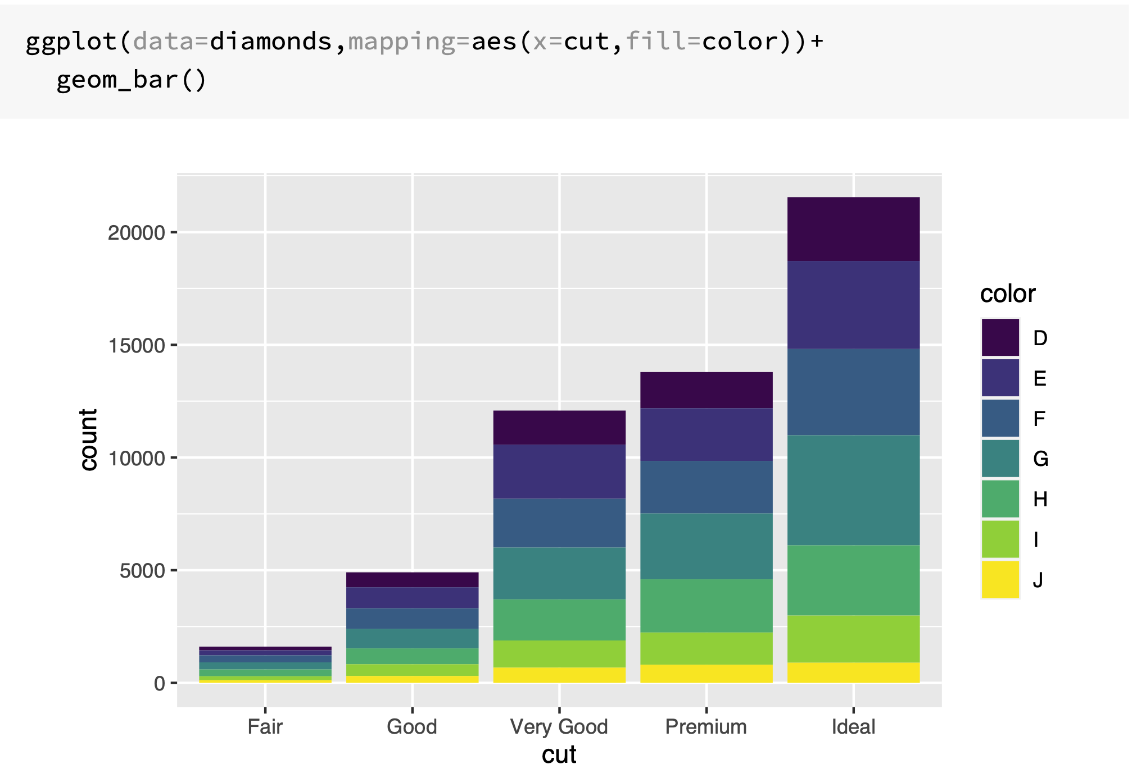

Slide 36
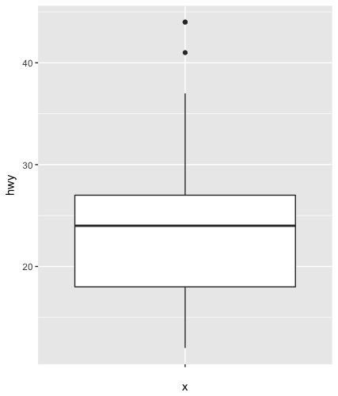
Boxplot
Display the distribution of a continuous variable broken down by a categorical variable
Box that stretches from the 25th to 75th percentile a distance known as the interquartile range (IRQ)
Median in the middle of box
Points outside more that 1.5 times the IQR from either edge of the box are displayed (outliers)
Whisker extends to the farthest non-outlier point in the distribution

Slide 37
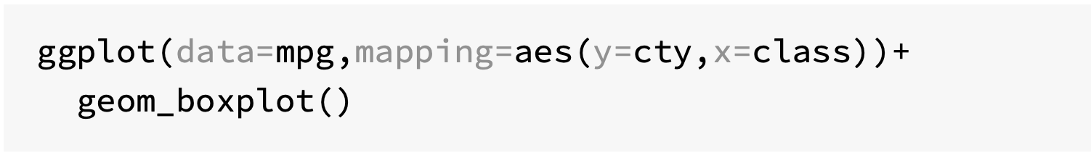
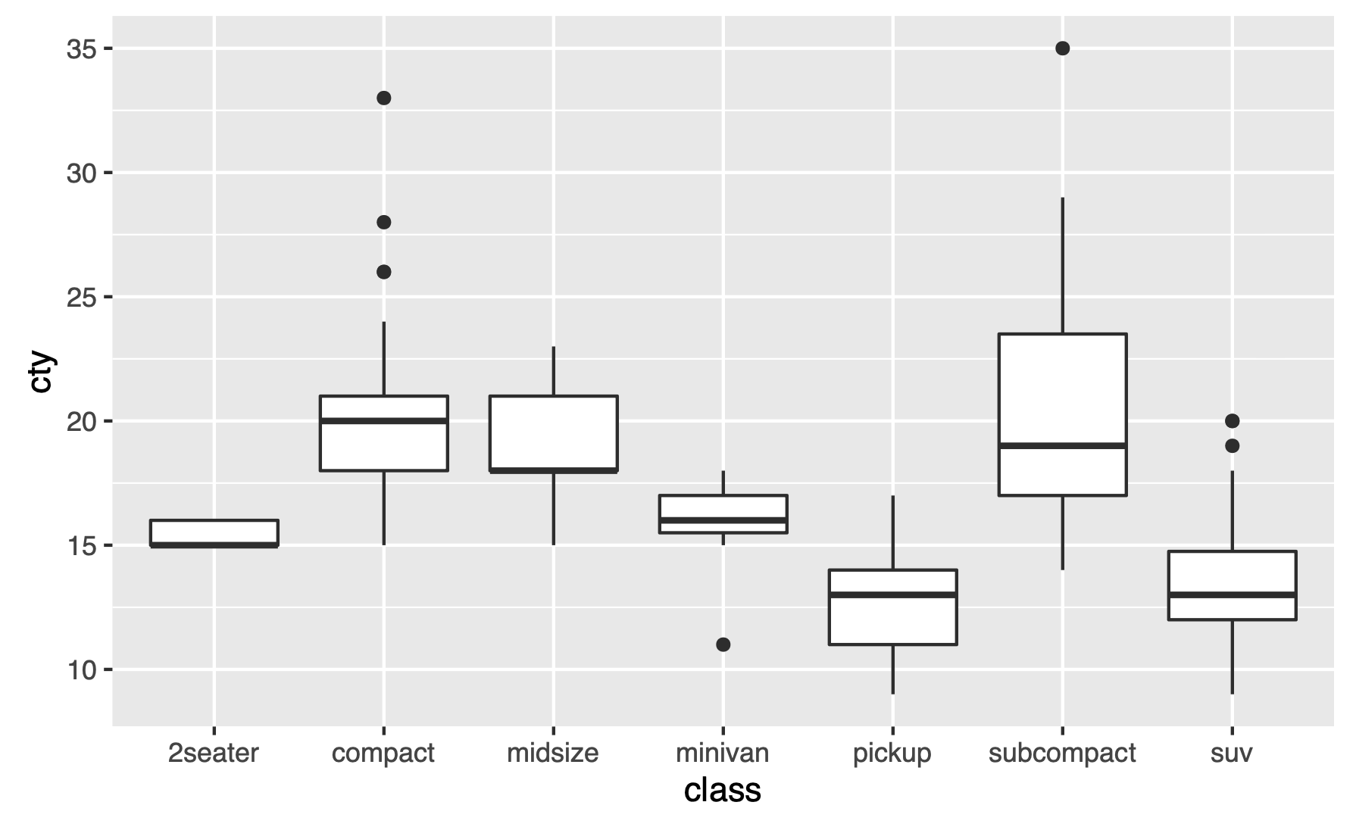

Slide 38
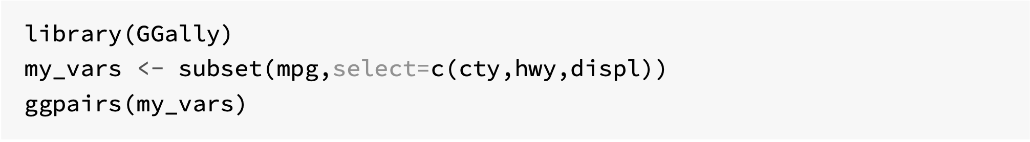
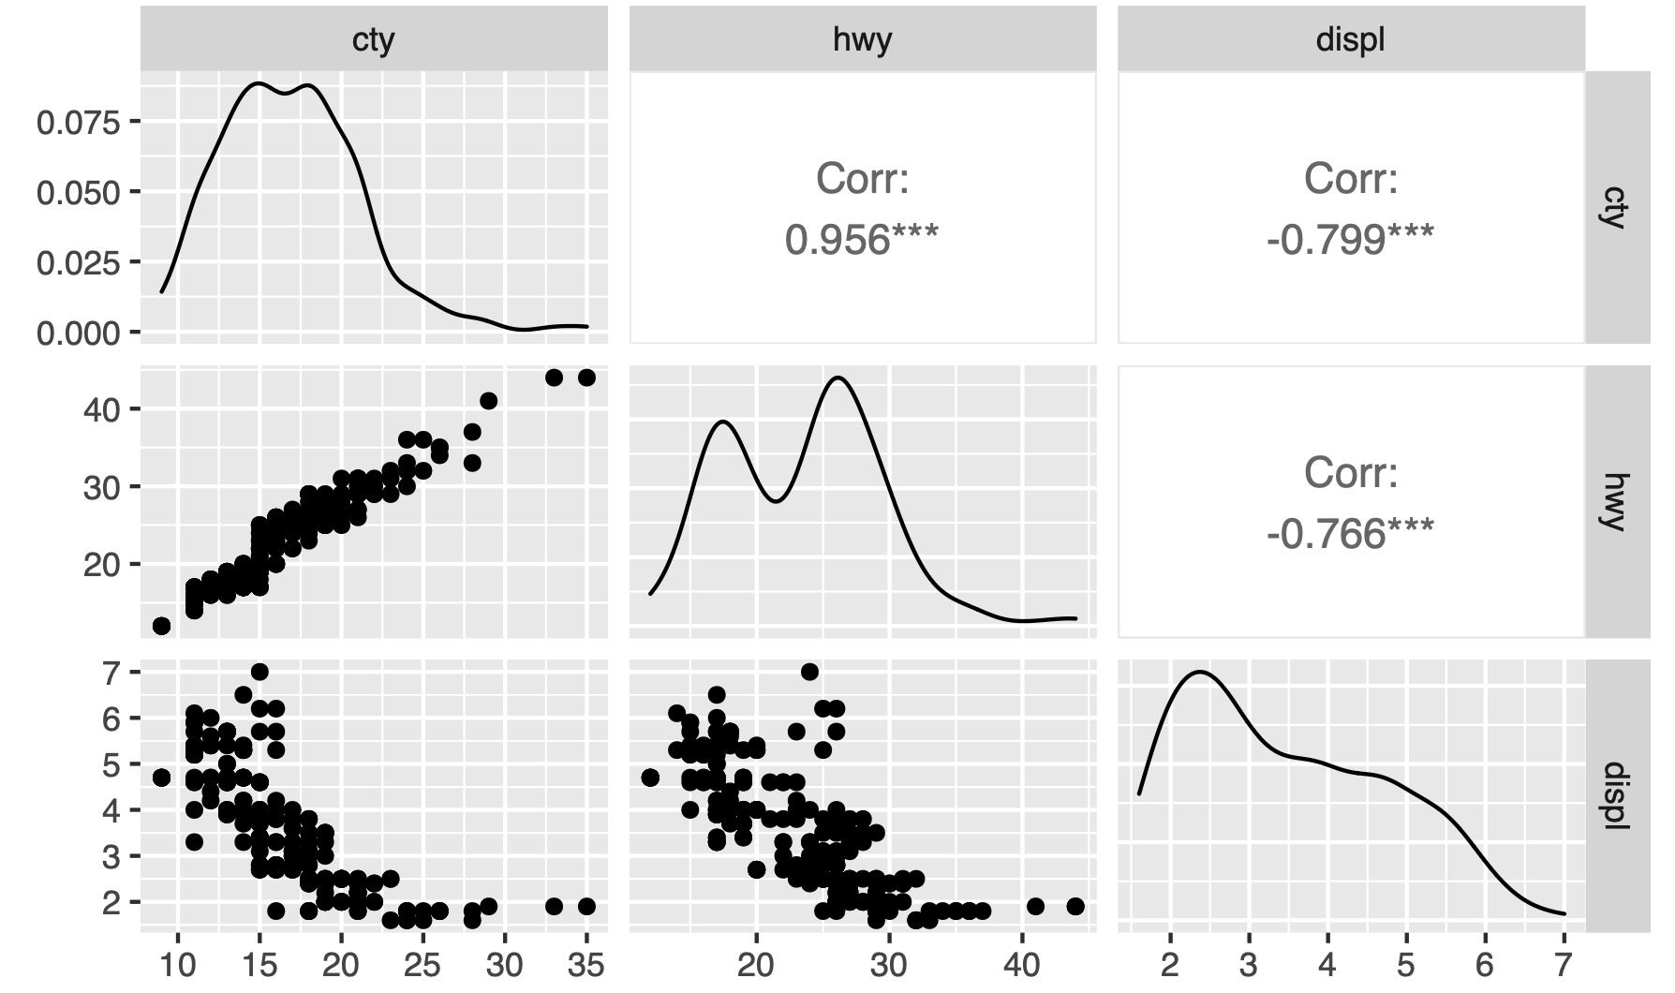
Covariation with ggpairs()

Slide 39
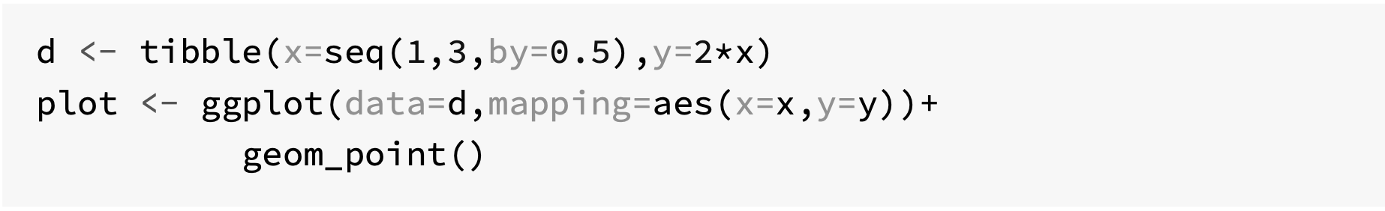
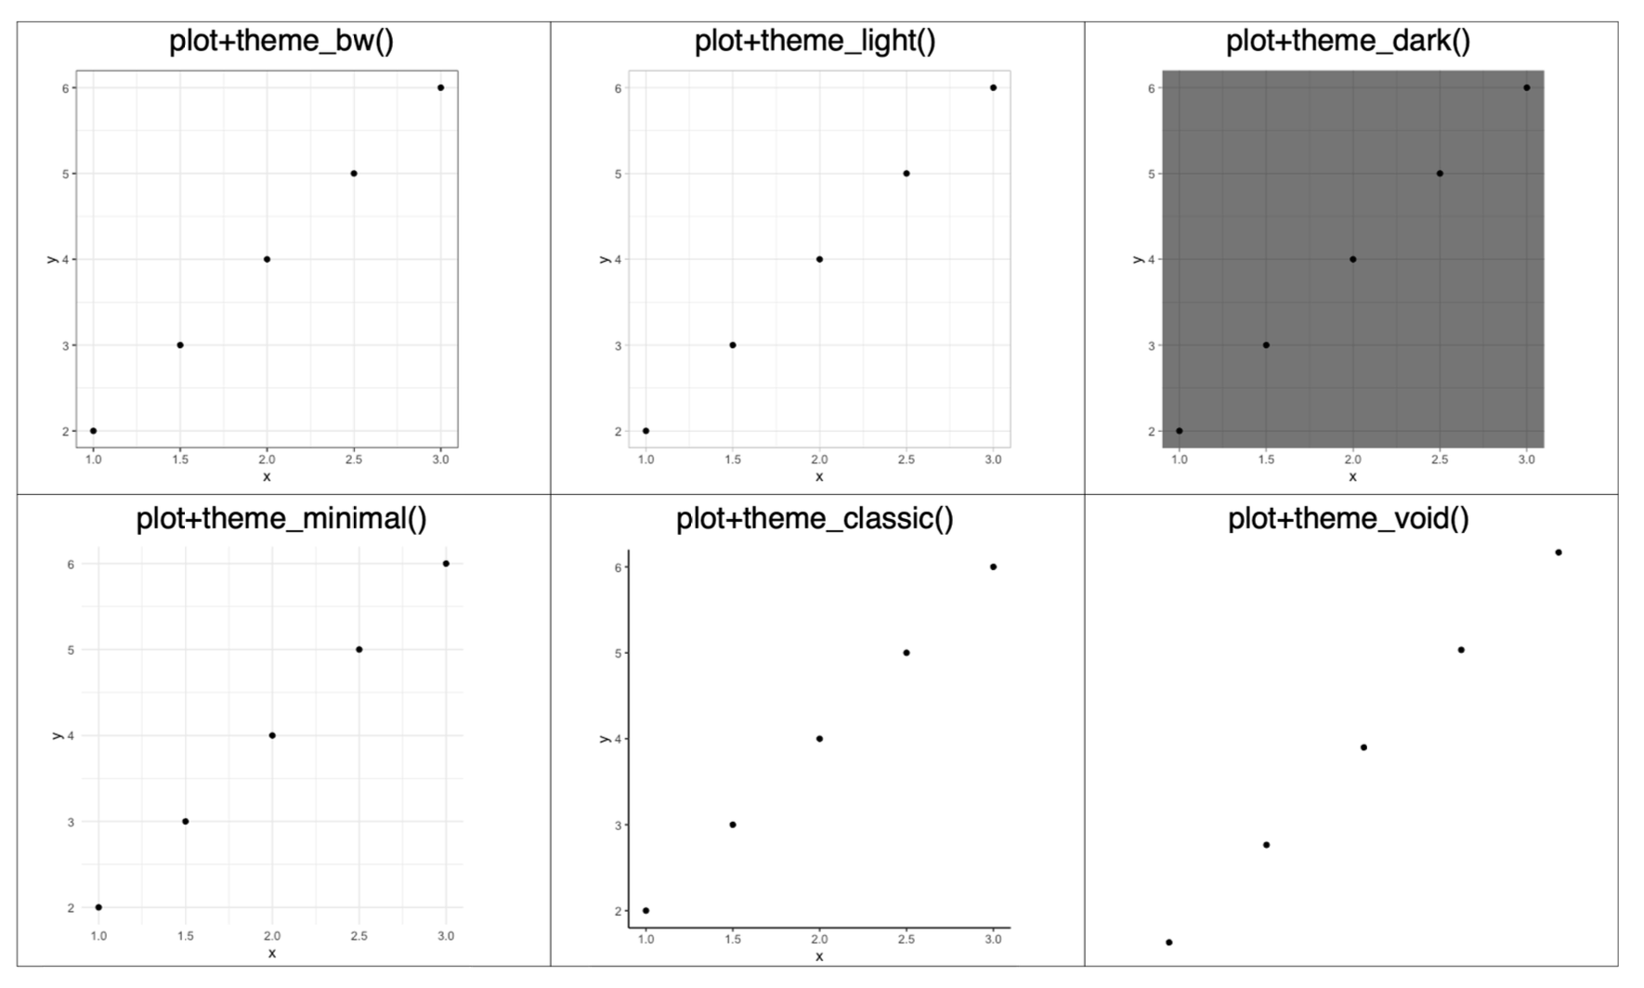
Ready to use themes

Slide 40
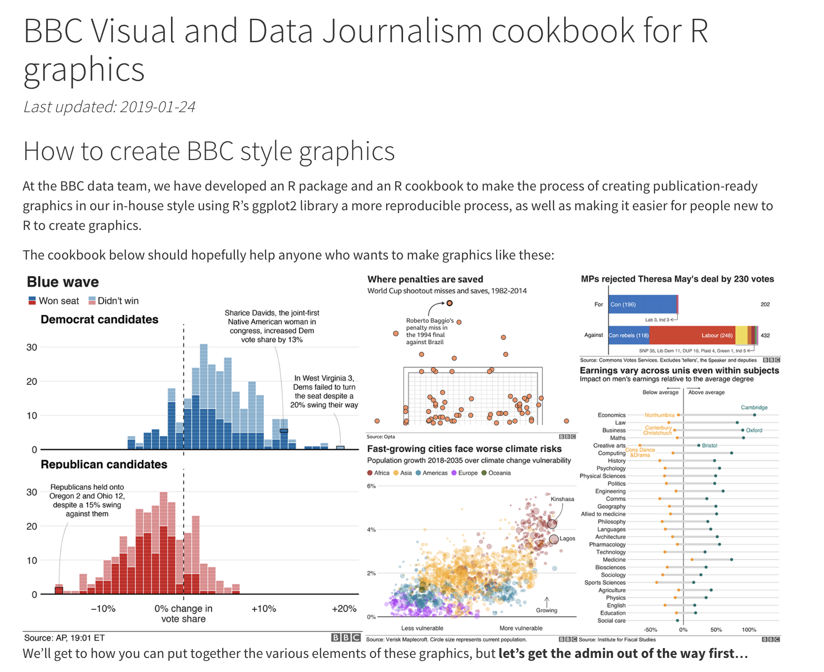
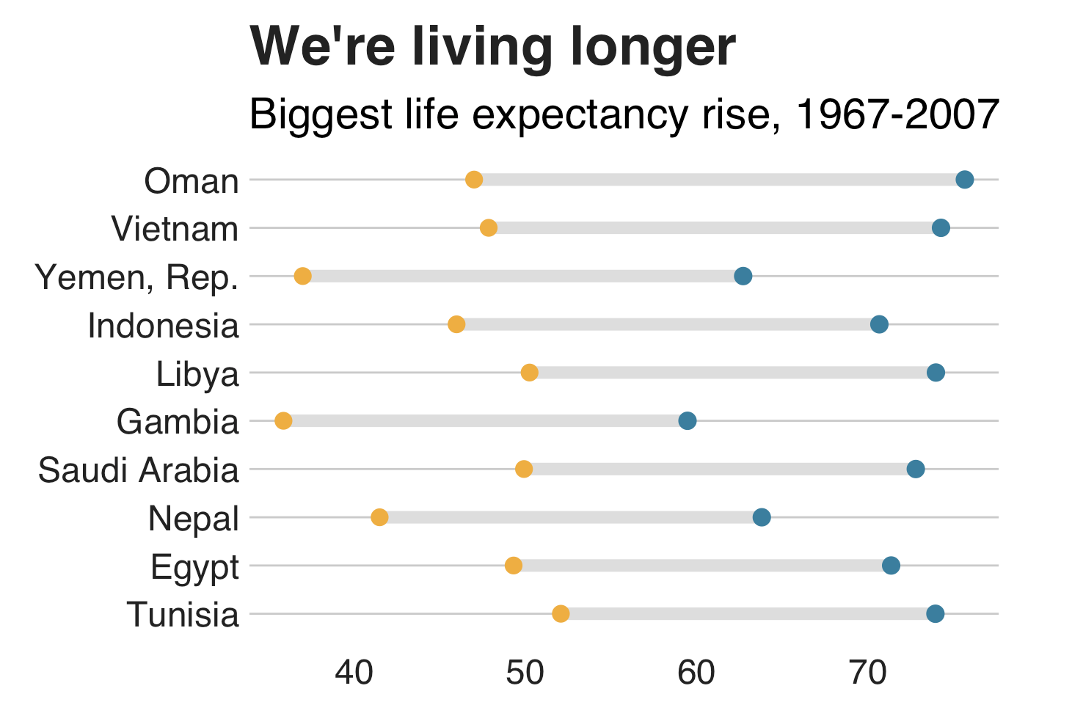
https://bbc.github.io/rcookbook/

Slide 41
Useful geoms
Geom | Purpose
geom_smooth() | Fits a smoother to data and displays the smooth and its standard error
geom_boxplot() | Produces a box-and-whisker plot to summarise the distribution of a set of points
geom_histogram() geom_freqpoly() | Shows the distribution of continuous variables
geom_bar() | Shows the distribution of categorical variables
geom_path() geom_line() | Draws lines between data points
geom_area() | Draws an area plot, which is a line plot filled to the y-axis. Multiple groups will be stacked upon each other
geom_rect() geom_tile() geom_raster() | Draw rectangles
geom_polygon() | Draws polygons, which are filled paths.

Slide 42
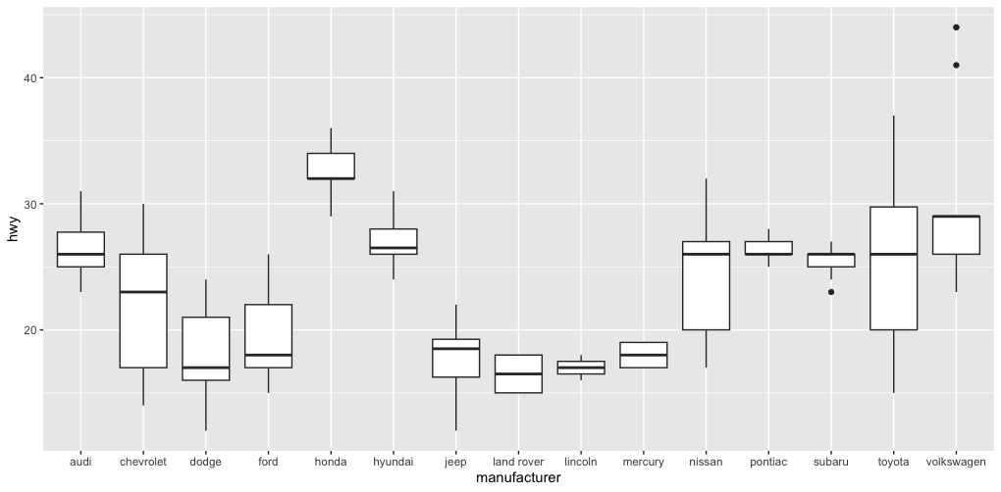
Challenge 3.2
Generate the following box plot (hwy by manufacturer) from mpg.

Slide 43
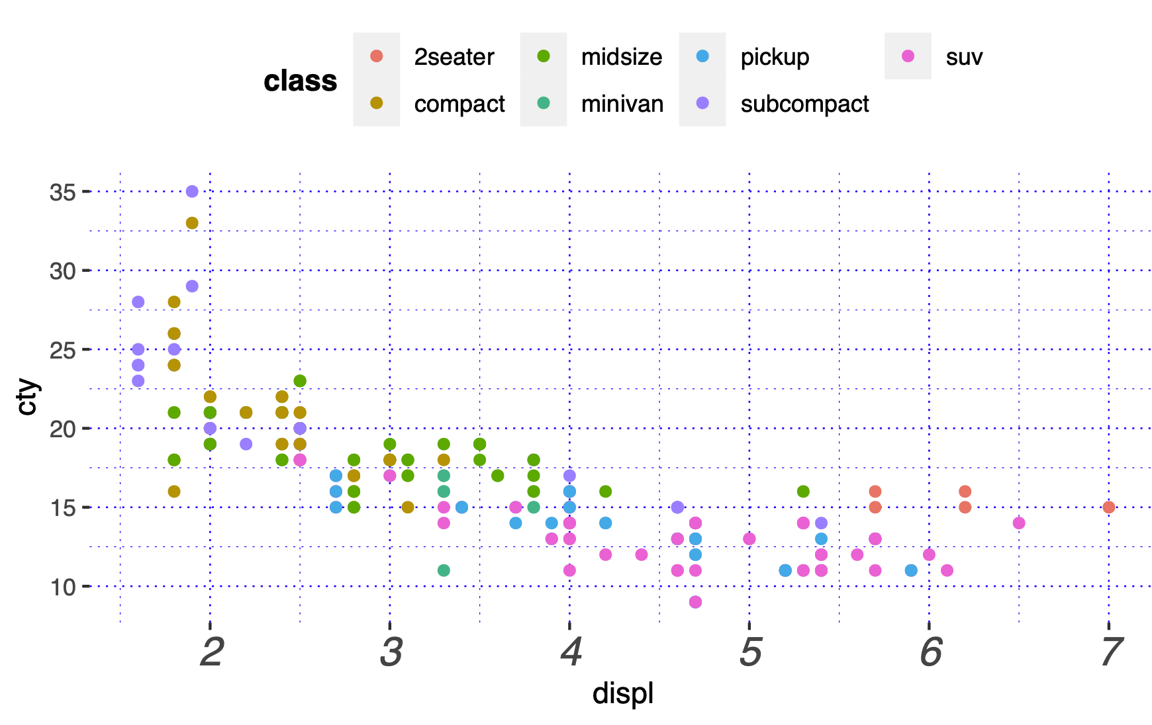
Summary
Layered grammar of graphics, enables us to concisely describe the components of a graphic.
Benefits:
plots can be designed in a layered manner (+ operator)
a wide range of plots can be generated to support decision analysis, including scatterplots, histograms and time series charts
charts can be developed rapidly, and this support an iterative process of decision support

Slide 44
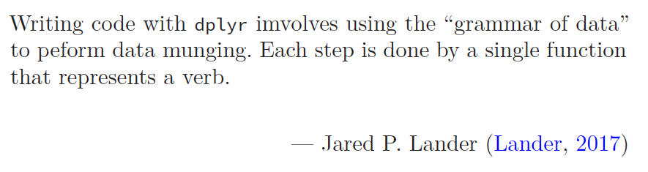
Exploring Operations Research with R: A Workshop
04 – dplyr
https://github.com/JimDuggan/Exploring-OR-with-R-Workshop

Slide 45
Topics Overview
Topic | Description | ~Timing
1 | Introduction to R and Posit Cloud | 10 mins
2 | Storing data using data frames / tibbles | 10 mins
3 | Visualisation with ggplot2 | 20 mins
4 | Data transformation with dplyr | 20 mins
5 | Using R with OR – Four Examples | 30 mins

Slide 46
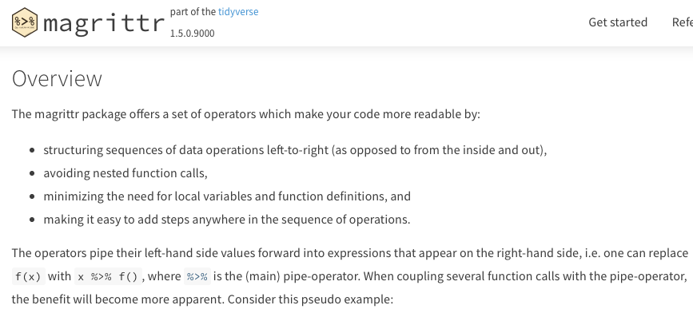
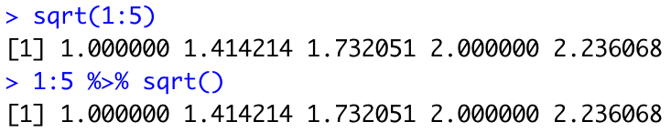
Combining operations with the Pipe
The pipe %>% comes from the magrittr package (Stefan Milton Bache)
Helps to write code that is easier to read and understand
x %>% f(y) turns into f(x, y)
x %>% f(y) %>% g(z) turns into g(f(x, y),z)
https://magrittr.tidyverse.org

Slide 47
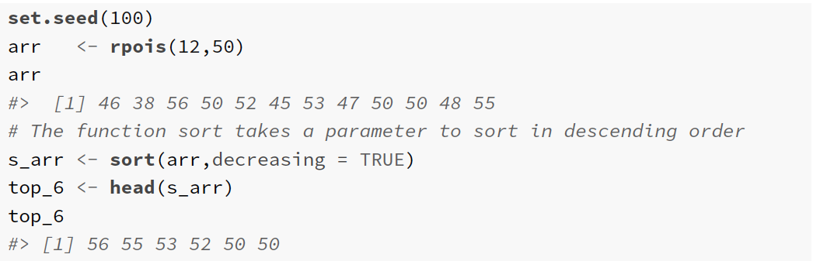
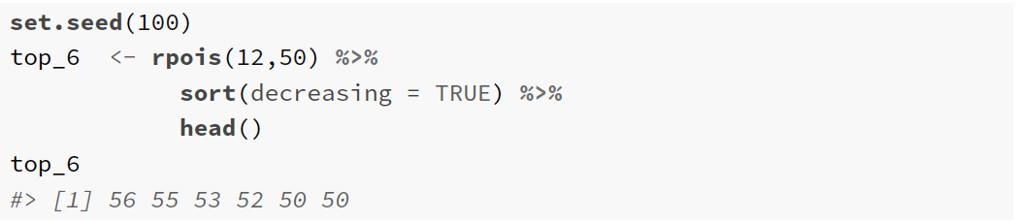

Slide 48
Utility of dplyr
Visualisation is an important tool for insight generation, but it’s rare that you get the data in exactly the right form you need (Wickham and Grolemund 2017)
Create new variables
Create summaries
Order data
dplyr package is designed for data transformation

Slide 49
dplyr Basics: 5 key functions
Function | Purpose
filter() | Pick observations by their values
arrange() | Reorder the rows
select() | Pick variables by their names
mutate() | Create new variables with functions of existing variables
summarise() | Collapse many values down to a single summary
”A grammar of data manipulation”
All verbs (functions) work similarly
The first argument is a data frame/tibble
The subsequent arguments decide what to do with the data frame/tibble
The result (data frame/tibble) supports chaining of steps – NOTE the “pipe operator” which we will cover later.
https://dplyr.tidyverse.org

Slide 50
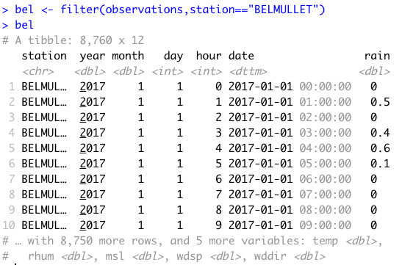
1. filter() aimsir17 tibble observations
First argument the name of the data frame
Subsequent arguments are expressions that filter the data frame
Subsequent arguments can be viewed as a succession of “and” statements
Number of columns does not change
Number of rows reduced (filtered)

Slide 51
Relational operators in R
Operators | Description
< | less than
<= | less than or equal to
> | greater than
>= | greater than or equal to
== | exactly equal to
!= | not equal to
!x | not x
x | y | x OR y
x & y | x AND y

Slide 52

Show rows for “MACE HEAD” in January

Slide 53

Useful approaches for filtering more than one value
%in% operator in R

Slide 54
Challenge 4.1
Show the weather for “ROCHES POINT” on October 16th at 12 midday. This should return just one observation.

Slide 55

2. arrange()
Changes the order of rows.
Used for sorting values
Takes a tibble and a set of column names to order by

Slide 56

Mean Sea Level Pressure

Slide 57

More than one value

Slide 58

In descending order - desc()

Slide 59
Challenge 4.2
Arrange the observations by month and by highest temperature

Slide 60

3. select()
It is not uncommon to get datasets with hundreds, or even thousands, of variables
A challenge is to narrow down on the variables of you’re interested in
select() allows you to rapidly zoom in on a useful subset using operations based on the variable names
Number of rows does not change

Slide 61


Useful options with select()

Slide 62

Special functions with select()

Slide 63


Examples

Slide 64

everything()

Slide 65
4. mutate()
It is often useful to add new columns that are functions of existing columns
mutate() always adds new columns at the end of your data set.
For example, convert the mph wind speed in observations to a new column, kph.
Use a simplified observations tibble with day, month, station, wdsp as columns, and for “ROCHES POINT” on October 16th
Assume 1 mi = 1.609344 km

Slide 66


Example of mutate

Slide 67
Useful Creation Functions
There are many functions for creating new variables that can be used with mutate()
The key property is that the function must be vectorised:
It must take a vector of values as input, and,
Return a vector with the same number of values as output

Slide 68
Challenge 4.3
Add a new column rain_in, which measures the hourly rainfall in inches
Assume a conversion constant of 1 mm = 0.0393701 inches

Slide 69
5. summarise()
The last key verb is summarise()
It collapses a data frame into a single row
Not very useful unless paired with group_by() (it will just perform a summary of the whole data set)
Very useful to combine with the pipe operator

Slide 70

group_by()
Most data operations are useful done on groups defined by variables in the the dataset.
The group_by function takes an existing tbl and converts it into a grouped tbl where operations are performed "by group”.

Slide 71

Key idea
This grouping can then be exploited by summarise

Slide 72
Overall idea…
Original data frame
Grouped data frame
group_by()
summarise()

Slide 73
Useful Summary Functions
Grouping | Examples
Measures of location | mean(), median()
Measures of spread | sd(), IQR(),mad()
Measures of rank | min((), quantile(), max()
Measures of position | first(), nth(), last()
Counts | n(), n_distinct()
Counts and proportions of logical values | sum(x>0) when used with numeric functions, (T,F) converted to (1,0)

Slide 74
Challenge 4.4
For “BELMULLET” calculate the total daily rainfall for October, and show using ggplot.

Slide 75
dplyr Summary: 5 key functions
Function | Purpose
filter() | Pick observations by their values
arrange() | Reorder the rows
select() | Pick variables by their names
mutate() | Create new variables with functions of existing variables
summarise() | Collapse many values down to a single summary
”A grammar of data manipulation”
All verbs (functions) work similarly
The first argument is a data frame/tibble
The subsequent arguments decide what to do with the data frame/tibble
The result (data frame/tibble) supports chaining of steps – NOTE the “pipe operator” which we will cover later.
https://dplyr.tidyverse.org

Slide 76
Exploring Operations Research with R: A Workshop
05 – Operations Research Examples
https://github.com/JimDuggan/Exploring-OR-with-R-Workshop

Slide 77
Topics Overview
Topic | Description | ~Timing
1 | Introduction to R and Posit Cloud | 10 mins
2 | Storing data using data frames / tibbles | 10 mins
3 | Visualisation with ggplot2 | 20 mins
4 | Data transformation with dplyr | 20 mins
5 | Using R with OR – Four Examples | 30 mins
Example | Description
1 | Exploratory Data Analysis
2 | Linear Programming
3 | Agent Based Simulation
4 | Data transformation with dplyr

Slide 78
(1) Exploratory Data Analysis
“Exploratory analysis is what you do to understand the data and figure out what might be noteworthy or interesting to highlight to others. When we do exploratory analysis, it’s like hunting for pearls in oysters.”
Cole Nussbaumer Knaflic (Knaflic, 2015)

Slide 79

EDA Code Examples
Iris Flowers
Titanic
Victoria Electricity
Boston Housing
Irish Weather

Slide 80


(1) Iris Data Set

Slide 81


(2) Electricity Demand (Victoria)

Slide 82

(3) Boston Data

Slide 83

(4) Titanic Survival Data

Slide 84

(5) Irish Weather Analysis (Winter)

Slide 85

(2) Linear Programming
“The success of an OR technique is ultimately measured by the spread of its use as a decision making tool. Ever since in introduction in the late 1940s, linear programming (LP) has proven to be one of the most effective operations research tools.”
Hamdy A. Taha (Taha, 1992)

Slide 86


The Reddy Mikks example (Taha 1995)

Slide 87




Slide 88


Slide 89


Slide 90


Slide 91


Slide 92

(3) Agent Based Simulation
Situate an initial population of autonomous heterogeneous agents in a relevant spatial environment; allow them to interact according to simple local rules, and thereby generate – or “grow” - the macroscopic regularity from the bottom up.
Joshua M. Epstein (Epstein, 2012)

Slide 93



Slide 94


A single run…

Slide 95

Three Scenarios (Different seeded individual)

Slide 96

Quantile analysis

Slide 97
(4) System Dynamics
“Everything we do as individuals, as an industry, or as a society is done in the context of an information-feedback system.”
Jay W. Forrester (Forrester, 1961)

Slide 98

Limits to Growth Model

Slide 99

deSolve

Slide 100


Slide 101




Slide 102



Slide 103

SIRH Model

Slide 104


Slide 105



Slide 106


Slide 107

Exploring scenarios: 2 policy levers

Slide 108

Speed of vaccination
No vaccination,
no change in mobility = Max point
Speed of mobility reduction

Slide 109

Recap.
R programming language can be a valuable tool – and way of thinking – which can be successfully applied to the field of operations research (OR).
Core R tools (tidyverse)
Application areas to OR:
Exploratory Data Analysis
Linear Programming
Agent-Based Simulation
System Dynamics

